Slide 1
Next two topics
K-Nearest Neighbors (classification, supervised method)
K-means (clustering, unsupervised method)

Slide 2
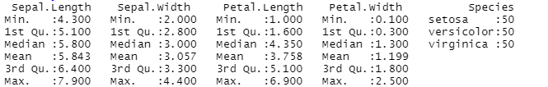
PCA – unsupervised method
Example: Iris data
data(iris)
summary(iris)
3 species of 50 instances each
Measurements in cm
From paper by Fisher (a classic, 1936, in pattern recognition literature)

Slide 3
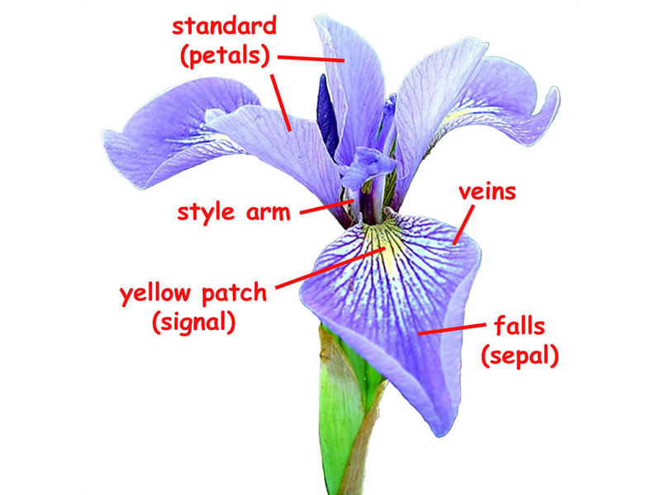
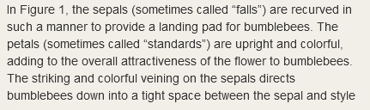
What is sepal length and petal length?
Domain knowledge

Slide 4
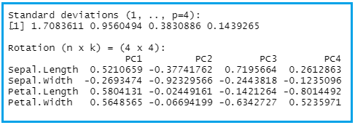
To scale or not to scale?
ir<- iris[,-5]
Remove the species so that we are left with features of the iris only.
ir <- iris[,-5]
pcairis <- prcomp(ir,scale = TRUE)
pcairis

Slide 5

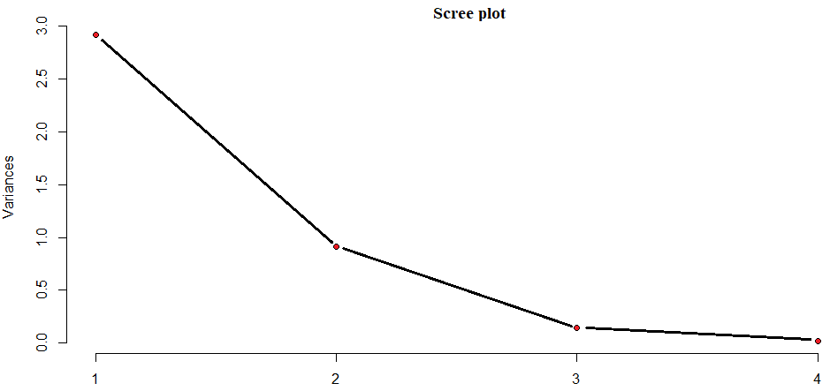
Summary, scree plot
summary(pcairis)
plot(pcairis, type = "l")

Slide 6
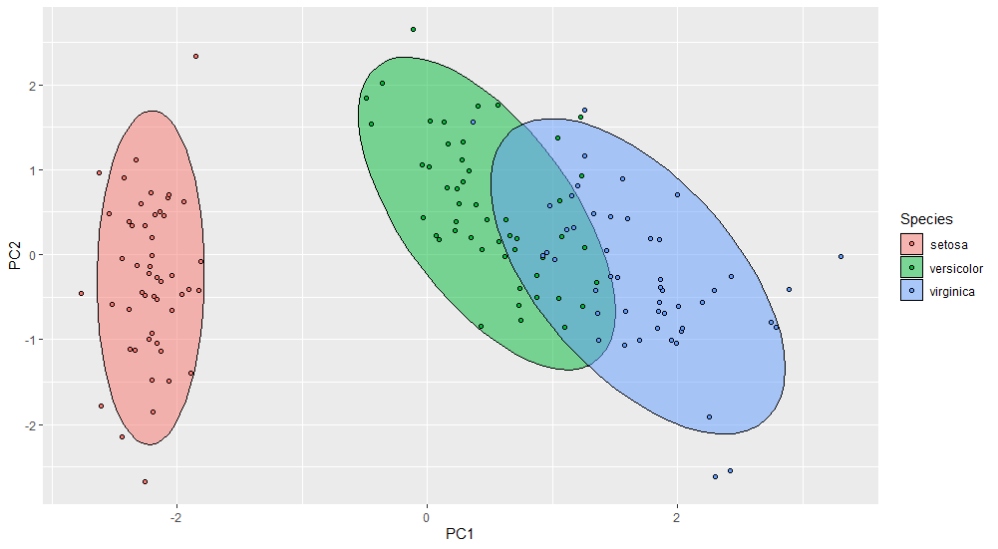
Component scores by species
iris2<-cbind(iris,pcairis$x[,1:2])
ggplot(iris2,aes(PC1,PC2,col=Species,fill = Species))+
stat_ellipse(geo="polygon",col = "black",alpha = 0.5)+
geom_point(shape = 21, col = "black")

Slide 7
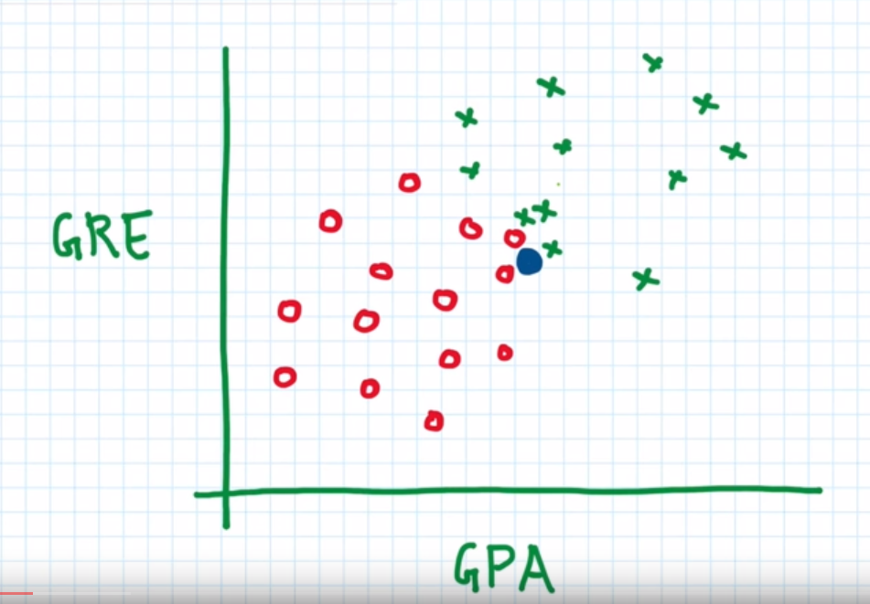
K-Nearest Neighbors (K-NN): Supervised, Non-Linear Classification Non-Parametric Algorithm
Accepted
Rejected
New data point,
Blue dot
K=3
P(Accepted) = 1/3
P(Rejected) = 2/3
Classify New data:
Rejected.

Slide 8
K-Nearest Neighbors (K-NN): Supervised, Non-Linear Classification Non-Parametric Algorithm
Accepted
Rejected
New data point,
Blue dot
K = 5
P(Accepted) = 3/5
P(Rejected) = 2/5
Classify new data
Accepted

Slide 9
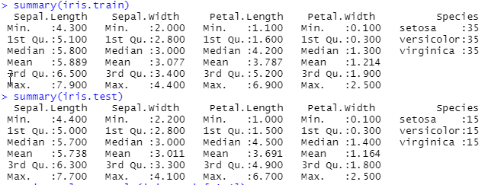
Return to iris data
Will need following packages: caret and class
data(iris)
set.seed(107)
#Partitioning data into training and testing
inTrain <- createDataPartition(y=iris$Species, p = .7,list = FALSE )
iris.train <- iris[inTrain,]
iris.test <- iris[-inTrain,]
summary(iris.train)
summary(iris.test)

Slide 10
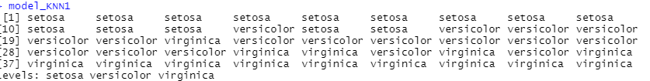
Feature Scaling and Fitting Model
train.scale <- scale(iris.train[,1:4])
test.scale <- scale(iris.test[,1:4])
train.target <- iris[inTrain,5]
Test.target <- iris[-inTrain,5]
model_KNN1 <- knn(train = train.scale,test=test.scale,cl=train.target,k=1)
model_KNN1

Slide 11
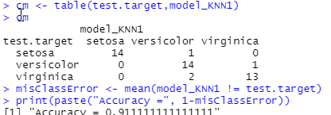
Confusion Matrix
cm <- table(test.target,model_KNN1)
cm
misClassError <- mean(model_KNN1 != test.target)
print(paste("Accuracy =", 1-misClassError))

Slide 12
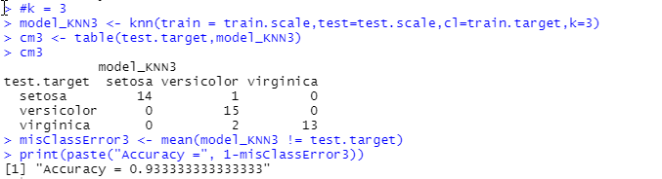
Changing K
#k = 3
model_KNN3 <- knn(train = train.scale,test=test.scale,cl=train.target,k=3)
cm3 <- table(test.target,model_KNN3)
cm3
misClassError3 <- mean(model_KNN3 != test.target)
print(paste("Accuracy =", 1-misClassError3))

Slide 13
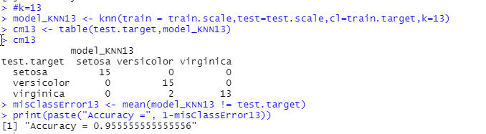
Rule of Thumb: square rt of sample size
#k=13
model_KNN13 <- knn(train = train.scale,test=test.scale,cl=train.target,k=13)
cm13 <- table(test.target,model_KNN13)
cm13
misClassError13 <- mean(model_KNN13 != test.target)
print(paste("Accuracy =", 1-misClassError13))

Slide 14
To be continued . . .
Up next: Kmeans Clustering

